Slide 1
Office 365 Development

Slide 2
Course Agenda
Introduction to Office 365 Development
Module 1: Overview of Office 365 Development
Module 2: Getting started with Apps for Office
Module 3: Getting started with Apps for SharePoint
Module 4: Getting started with the Office 365 APIs
Module 5: Moving Full Trust Code to the Cloud Using Repeatable Patterns and Best Practices
Module 6: Getting started with Mobile development with Office 365
Module 7: Setting up your Developer environment in Office 365
Module 8: Setting up your on-premises environment for app development

Slide 3
Getting started with Mobile development with Office 365

Slide 4

Agenda
Intro
Native Development
Multi-Platforms Development

Slide 5
Intro
Getting started with Mobile development with Office 365

Slide 6
Developer vision
USERS
DATA
HTML

Slide 7
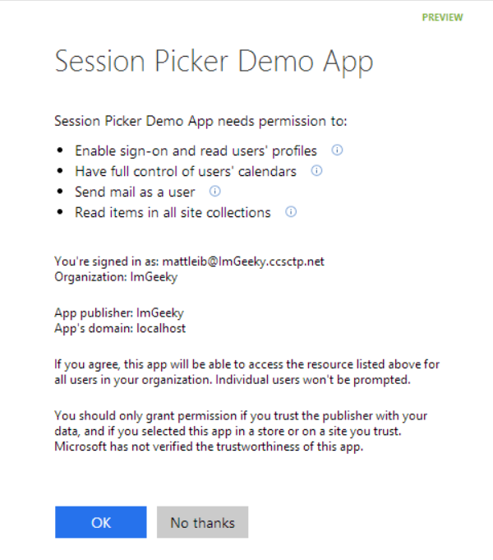
Azure AD OAuth in Office 365
Single authentication flow
Across all Office 365 services
“Native” apps and web sites
Admin and end-user consent
Secure protocol
OAuth 2.0 (no capturing user credentials)
Fine-grained access scopes
Supports MFA and federated user sign-in
Long-term access through refresh tokens
Unique Considerations of “Native” Azure Apps
Inherently multi-tenant
No client/app secret (think about distribution)
Leverage a web authentication window/broker (via ADAL)
No application-only permissions (can go through proxy service)

Slide 8

Native Mobile Apps

Slide 9
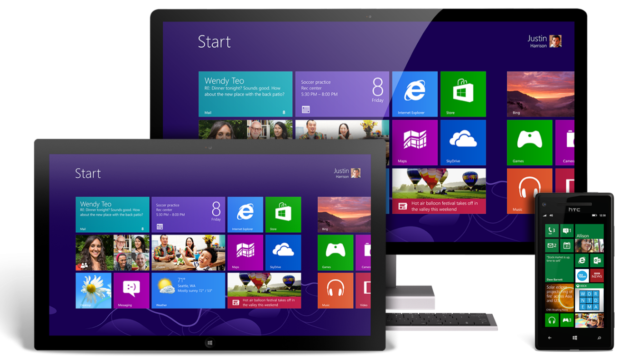
Universal Windows Apps
About
Build application that runs across Windows Phones, tablets and PCs
Windows 10 realizes the convergence of Phone and PC
Development
IDE: Visual Studio 2015 w/ Windows SDK for Windows 10
App Registration: Add Connected Service Wizard
SDK Integration: Add Connected Service Wizard
When to use
Target device footprint is exclusively Windows
Application needs unique device-specific capabilities (ex: Cortana)
Complex/Advanced user experience or visualizations
Applications with strict enterprise requirements

Slide 10
Universal Windows Apps
Solution Structure and Debugging
Windows 10 solutions are truly universal with a single project
Template allow debugging against emulators or physical devices
Additional Tips
Must make UI responsive (vs separate UIs in 8.1 Universal Apps)
Take advantage of the best Windows 10 offers
Consider ADAL vs the new Web Account Manager (next slide)

Slide 11
demo
Universal Windows Platform
Notes:
Demo UWP with Web Account Manager: https://github.com/OfficeDev/MyFiles-API-Win10_UWP

Slide 12

Android
About
Open source Office 365 SDK for Android by MS Open Tech (3/2014)
Available on GitHub (http://bit.ly/14JCgWZ)
Also requires ADAL for Android (http://bit.ly/1E7IfSi)
Development
IDE: Android Studio (or Eclipse)
App Registration: Azure Management Portal
SDK Integration: build.gradle (similar to NuGet for dependencies)
When to use
Target device footprint is exclusively Android
Application needs unique device-specific capabilities
Complex/Advanced user experience or visualizations

Slide 13
Android
Solution Structure
Form design (UI) is defined in .XML files (app\src\main\res\layout)
Form logic is defined in .java files deriving from Activity
Build.gradle references dependencies
AndroidManiest.xml is the app configuration file
Debugging
Debug apps with emulators (warning: SLOW) or Android device
Consider Genymotion emulators that install separate from IDE
Visual Studio 2015 Emulator
Additional Tips
Make sure you give the app permission to use the internet (in AndroidManifest.xml)
Controls aren’t automatically referenced in form logic (must use findViewById)

Slide 14
demo
aNDROID
Notes:
If you have it, Demo Android Studio…else show:
ADAL for Android on GitHub: https://github.com/AzureAD/azure-activedirectory-library-for-android
Office 365 SDK for Android on GitHub: https://github.com/OfficeDev/Office-365-SDK-for-Android

Slide 15

iOS
About
Open source Office 365 SDK for iOS by MS Open Tech (10/2014)
Available on GitHub (http://bit.ly/155NpCI)
Also requires ADAL for iOS (http://bit.ly/1u9Mexa)
Apple does not permit compilation of iOS apps without Mac
Development
IDE: Mac and XCode (Objective C or Swift)
App Registration: Azure Management Portal
SDK Integration: Cocoapods or manual build/copy
When to use
Target device footprint is exclusively iOS
Application needs unique device-specific capabilities
Complex/Advanced user experience or visualizations

Slide 16
iOS
Solution Structure
Form design (UI) is defined in .storyboard files and logic is defined in view controllers
References can be in the form of static libraries (.a) or frameworks (.framework), which include header files
ADAL for iOS is a static library and the Office 365 SDK for iOS is a framework
Debugging
XCode includes a really nice iOS emulator for debugging
Registered Apple Developers ($99) can debug on physical iOS devices
Additional Tips
Combine ADAL builds for emulator and physical device
Use bridging header files for Objective-C references in Swift projects
Println and Watch Expressions are really helpful tools for noobs

Slide 17
demo
Ios AND xcode
Notes:
Demo xcode and O365 native app if you have a MAC…else show:
ADAL for Android on GitHub: https://github.com/AzureAD/azure-activedirectory-library-for-objc
Office 365 SDK for Android on GitHub: https://github.com/OfficeDev/Office-365-SDK-for-iOS

Slide 18

Cross-Platform Mobile Apps

Slide 19

Apache Cordova
About
Platform for developing mobile apps with HTML, CSS and JavaScript
Open source collection of JavaScript that abstracts device-specific APIs
All web assets are copied local to the device and run “Chromeless”
Foundation for PhoneGap, AppBuilder, Ionic, etc
Development
IDE: >= Visual Studio 2013 w/ Update 4 and VS Tools for Cordova CTP3*
App Registration: Add Connected Service Wizard
SDK Integration: Add Connected Service Wizard
When to use
Multi-tenant apps or apps that target multiple mobile platforms
Developers are skilled in web development (HTML, CSS, JavaScript)
Licensing costs prohibit other cross-platform frameworks

Slide 20
Apache Cordova
Solution Structure
Office 365 assets installed under /services/office365
Settings.js defines app details (client id, app redirect, etc)
o365Loader.js dynamically adds Office 365 SDK references to pages
Debugging
Debug in Ripple (in-browser emulator), emulators, or physical devices
Debug iOS w/ remote Mac (can use emulator or remote/local device)
Additional Tips
Numerous Cordova plug-ins exist for rich device integration (Custom with Git)
Use NuGet to reference additional packages (Bootstrap, Angular, etc)
Cordova renders HTML…no native controls (w/o additional references)

Slide 21
demo
cordova
Notes:
Demo Cordova from Visual Studio 2015:
add connected service
Show scripts that get pulled in
Show settings.js that contains the app details
Show o365loader.js that bootstraps all the other scripts
Good completed app to demo: https://github.com/OfficeDev/Contacts-API-Mobile-App-with-Cordova-and-Ionic

Slide 22
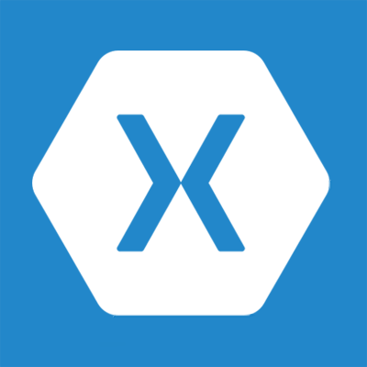
Xamarin
About
Xamarin is a Company (ISV) and Development Platform (Licensed)
Development based on .NET and complies to native platforms (Mono)
Xamarin provides up-to-date versions of .NET for iOS and Android
Development
IDE: Visual Studio 2013 with Xamarin Studio*
App Registration: Add Connected Service Wizard
SDK Integration: Add Connected Service Wizard
When to use
Multi-tenant apps or apps that target multiple mobile platforms
Development shop looking to leverage existing skills in C# and .NET
Want cross-platform with a native UX feel (ie – native controls)
Want cross-platform with full access to device capabilities

Slide 23
Xamarin
Solution Structure
Xamrin project templates for device-specific platforms or shared
Shared projects use shared portable libraries and device-specific projects (similar to Universal Windows Apps)
Xamarin.Forms allows UI layouts to be shared but render native controls across Android, iOS and Windows (can also use native layouts)
Debugging
Debug Android/Windows with emulators or physical devices
Debug iOS w/ remote Mac and Xamarin.iOS (can use emulator or remote/local device)
Additional Tips
Xamarin binding project allow ADAL/SDK references
ADAL v3 can help with binding challenges
See: http://www.cloudidentity.com/blog/2015/07/22/USING-ADAL-3-X-WITH-XAMARIN-FORMS/

Slide 24
demo
XAMARIN
Notes:
Demo Xamrin project in Visual Studio…show forms options between native and Xamarin Forms
Add connected service

Slide 25
Mobile Platform Decision Tree

Slide 26
Summary
Intro
Native Development
Multi-Platforms Development

Slide 27
Further reading…
Getting Started with APIs
Mobile dev Code Samples
Mobile dev Training videos & hands on labs
Office 365 API documentation

Slide 28
Developer Program Launch
1 YEAR FREE
E-mail Newsletters
Free Developer Subscription
Free Training
Free Tools
Webinars
http://dev.office.com/devprogram

Slide 29


Engage
Office 365 Network
https://www.yammer.com/itpronetwork
Twitter
S
S
t
t
a
a
r
r
t
t
@OfficeDev
Stack overflow
[ms-office]
Channel 9 Dev Show
http://aka.ms/O365DevShow
Podcasts http://dev.office.com/podcasts
Snack Demos
http://aka.ms/o365DevSnackDemos
UserVoice
http://officespdev.uservoice.com/

